Slide 1
TITLE PAGE 2023 UNIT KICKOFF

Slide 2
WHY SELL POPCORN?
Fund [Unit #] Adventures
[Insert your Unit Leader Planner Adventures and Expenses here]
Examples
Campouts
Blue & Gold Celebration
Pinewood Derby
High Adventures
Equipment needs
Advancement
Annual dues
Scouts Learn
The value of hard work
How to earn their own way
Public speaking
Salesmanship and people skills
Setting and achieving goals
Money management
Scouts Earn
The Scouts will love the REWARDS!!
Millions of choices with Amazon Gift Cards

Slide 3
TRAIL’S END TECHNOLOGY
Trail’s End App
Record sales (We Prefer Credit)
Sign up for Storefronts
Track your progress towards your goal
Record deliveries
Share online sales page
Claim rewards
Trail’s End Accounts
Already have an account?
You can use the same one
If you need to update your Unit, you can do so under ‘Settings’
Need an Account?
Click ‘Register’ from the home screen
You will need to know:
Insert Council Name
Insert District Name
Insert Unit Name

Slide 4
NEW THIS YEAR!
Insert any new Unit popcorn announcements here

Slide 6
WAYS TO SELL
ONLINE DIRECT
STOREFRONT SALES
WAGON SALES
Sell online & ship directly to customers.
Leverage high foot traffic locations reserved by Unit Leaders.
Direct sales to family, friends, neighbors.
Record in the app or share your online page
Share your page via email, text, social media or QR code
No handling products or cash
Average Order: $65
Products & prices may vary
Shipping/Tax may be charged
Available year round
Sign up to sell in front of a store
Average Sales: $XXX per hour
One parent and one Scout is ideal to cover more hours
Insert Storefront split information if your Unit is using one
Have parents ask co-workers
Be sure to mark sales delivered or undelivered
Delivered: Check out popcorn in advance, hand over products immediately
Undelivered: Take an order to deliver products later
TIP: Always make sure you see a confirmation screen before navigating away

Slide 7
CREDIT CARDS
Tell your customers
“We prefer credit/debit”
Trail’s End pays the credit card fees*
Scouts receive higher reward points
Scouts & leaders handle less cash
TE App works with Square readers or card information can be entered manually
When choosing a Bluetooth reader, you can also accept Apple Pay and Google Pay
Parents can pay their cash due for wagon sales (Click ‘Pay Now’ on the Wagon Sales screen)**
*TIP: You must use the Trail’s End app for credit card fees to be covered (no need for the Square app)
**NOTE: Using Pay Now does not count as a credit card sale for Trail’s End rewards points

Slide 8
GET READY TO SELL
CREATE AN ENGAGING & ENERGETIC PITCH FOR THE SALE!
Perfect Your Sales Pitch
Introduce yourself and where you are from
Hello, I’m_____ from [Unit #]
Let people know what you are doing
I’m earning my way to summer camp
Close the sale
Can I count on your support?
End with a pitch for credit cards
We prefer credit/debit
Sales Tips
Always wear your field uniform (Class A)
Always speak clearly and say ‘Thank you.”
Download the app and login in advance
The more people you ask, the greater your sales
Know your products
Have an answer ready for “What is your favorite flavor?”
Ask the customer to support you/Scouting
Check out the training section of the app for: How to guides, more tips, and resources

Slide 9
GET READY TO SELL
More Tips & Training
Practice your sales presentation
Never sell alone or enter anyone’s home
Always walk on the sidewalk and/or driveway
Have mom and/or dad take the Trail’s End App or order form to work
Remember, 2 out of 3 people will buy when asked at their door
Set a GOAL!
Plan out how many sales you will need to reach your sales goal. Determine whom you will ask to help you reach your goal

Slide 10
A SUCCESSFUL SALE
HOW TO SELL OVER $1000 IN UNDER 8 HOURS
Personalize
5 MINS: Download the Trail’s End App, register an account, and personalize your account. Set a goal, add photos and a short bio on why you’re fundraising.
Storefront
4 HOURS: Sign up and sell for at least 4 hours. The average Scout sells over $150/hr at storefronts!
Pro Tip, make the most of your storefront time by working with only one Scout and parent per shift!
Online Direct
Wagon Sales
3 HOURS: Go door-to-door in your neighborhood, with or without product, and ask your community for their support. The average Scout sells over 100/hr!
10 Minutes: Talk with friends and family that live outside of your community. Post your Online Scout Page link to social media and ask for support. Get the word out to those out of town and not in your state! The average customer spends $65 Online!
Pro Tip, wear your uniform, and practice your popcorn sales pitch!

Slide 11
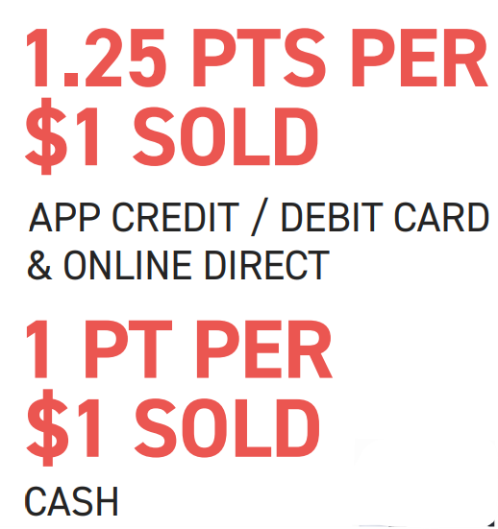
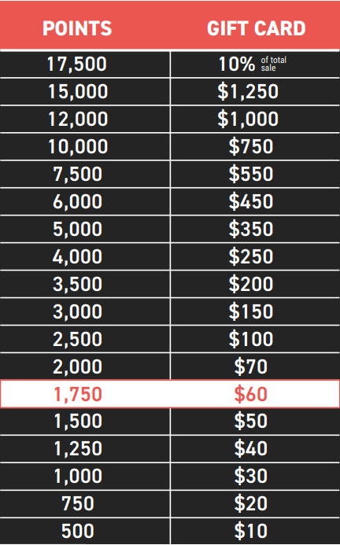
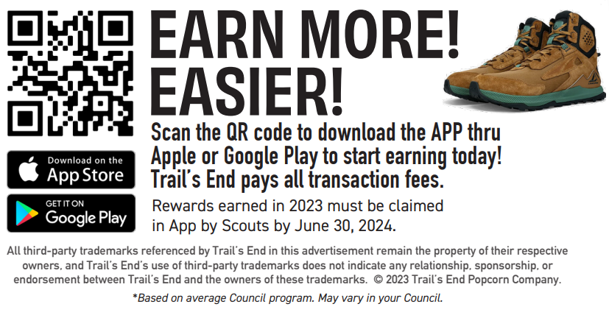
Rewards

Slide 12
KEY DATES
Add these dates to your Calendar
Storefronts available for signup: [Date]
Storefront sales begin: [Date]
Wagon sale begin: [Date]
Last day to return Wagon inventory: [Date]
Last storefront sale: [Date]
Final orders due: [Date]
Any cash collected due to Popcorn Kernel: [Date]
Final order distributed (including Chocolate): [Date]
Popcorn Celebration! [Date]

Slide 13
HAVE QUESTIONS?
GET ANSWERS
Trail’s End Support
Join our Facebook Group
Text PARENTFB to 62771 to join or visit
Visit our FAQ’s
https://support.trails-end.com
Unit Leaders
Name
Email Address
Phone number
Name
Email Address
Phone number

